Slide 1
309: Drug and Alcohol Issues: An Introduction for Child Welfare Professionals

Slide 2
Adult Learning
Adults, statistically retain:
10% of what they read
20% of what they hear
30% of what they see
50% of what they see and hear
70% of what they say or discuss with others
80% of what they experience personally
90% of what they say and do
Source: Glaser, R. (1983, June). Education and Thinking: The Role of Knowledge. Technical Report No. PDS-6. Pittsburgh, PA: University of Pittsburgh, Learning and Development Center.

Slide 3
Competencies
110-2 Assessment: The child welfare professional gathers relevant information and engages in critical thinking, utilizing a strength-based perspective and the competency model leading to an ongoing, accurate, and comprehensive assessment process.
110-3 Teaming: The child welfare professional assembles teams within and across organizations that are inclusive of family members utilizing and contributing to a collaborative approach throughout all phases of the child welfare process.
110-4 Planning: The child welfare professional facilitates the planning, development, and coordination of relevant information to a well-reasoned sequence of strategies and goals to achieve sustainable and beneficial results.

Slide 4
Learning Objectives
Participants will be able to:
Describe the laws, policies, and guidelines that guide services for children and families with drug and alcohol issues
Discuss the connection of services between the drug and alcohol system and the child welfare system
Recognize how drug and alcohol issues affect the case process in child welfare
Describe how and when drug and alcohol issues affects the permanency planning process for caseworkers
Identify the issues involved in planning a placement for a child and family involved in drug and alcohol
Apply permanency-planning principles to the casework process when drug and alcohol issues are involved

Slide 5
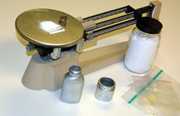
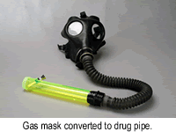
Examples of Drug Paraphernalia
Scale to weigh drugs
Gas mask converted to drug pipe
Photos Retrieved September 28, 2005 from Public Domain Resource Sites: http://www.usdoj.gov/dea/concern/paraphernaliafact.html and http://www.ohsinc.com/photos_drug_photos_pictures_drug_paraphernalia_drug_lab_photos.htm

Slide 6
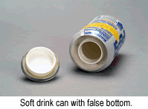
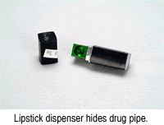
Examples of Drug Paraphernalia (cont’d)
Soft drink can with false bottom
Lipstick dispenser hides drug pipe
Photos Retrieved September 28, 2005 from Public Domain Resource Sites: http://www.usdoj.gov/dea/concern/paraphernaliafact.html and http://www.ohsinc.com/photos_drug_photos_pictures_drug_paraphernalia_drug_lab_photos.htm

Slide 7
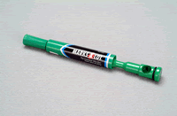
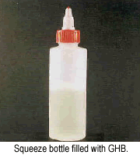
Examples of Drug Paraphernalia (cont’d)
Felt tip marker with internal drug pipe
Squeeze bottle filled with GHB
Photos Retrieved September 28, 2005 from Public Domain Resource Sites: http://www.usdoj.gov/dea/concern/paraphernaliafact.html and http://www.ohsinc.com/photos_drug_photos_pictures_drug_paraphernalia_drug_lab_photos.htm

Slide 8
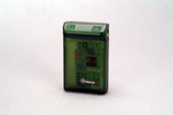
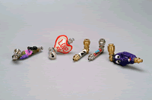
Examples of Drug Paraphernalia (cont’d)
Hollow pager adapted to conceal drugs
Assorted collection of drug pipes
Photos Retrieved September 28, 2005 from Public Domain Resource Sites: http://www.usdoj.gov/dea/concern/paraphernaliafact.html and http://www.ohsinc.com/photos_drug_photos_pictures_drug_paraphernalia_drug_lab_photos.htm

Slide 9
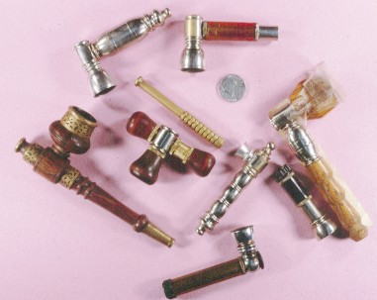
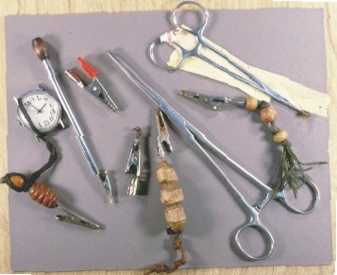
Examples of Drug Paraphernalia (cont’d)
More assorted drug pipes
Various clips for holding marijuana cigarettes
Photos Retrieved September 28, 2005 from Public Domain Resource Sites: http://www.usdoj.gov/dea/concern/paraphernaliafact.html and http://www.ohsinc.com/photos_drug_photos_pictures_drug_paraphernalia_drug_lab_photos.htm

Slide 10
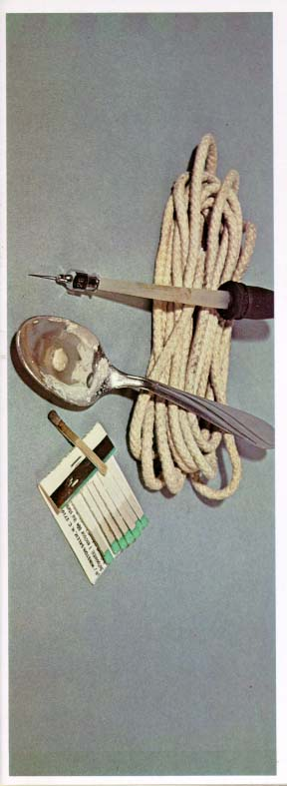
Examples of Drug Paraphernalia (cont’d)
Spoons and matches used to “cook up” drugs. Syringe and rope tie for shooting drugs into system.
Photo Retrieved September 28, 2005 from Public Domain Resource Sites: http://www.usdoj.gov/dea/concern/paraphernaliafact.html and http://www.ohsinc.com/photos_drug_photos_pictures_drug_paraphernalia_drug_lab_photos.htm

Slide 11
Characteristics of Families Affected by Substance Dependency/Abuse
Leads to:
An anxious family environment
Inconsistent parenting
Unpredictable rules
Rigid external boundaries
Inadequate personal boundaries
Secrets/shame-based life
Role reversal
Victim blaming/scapegoating
Lack of:
Self-Actualization
Esteem
Love, Affection, Belonging
Safety
Physiological
=

Slide 12
The Goals of Treatment
Identify chemical dependency
Help individual to identify the denial; confront that denial
Teach individual about his/her illness
Teach individual what to do about it (ex., Twelve Step Groups)
Teach individual how to prevent relapse
Work with individual to resolve problems (Post-Acute Withdrawal Syndrome)

Slide 13
Phases of Treatment
Getting clean and sober
Stabilization
Follow-up support and aftercare

Slide 14
Definition of Denial
Terence Gorski, N.C.A.C. II, C.S.A.C., a well-known professional in the field of addiction, defines denial as:
“… a normal response/defense for coping with painful and overwhelming problems. [Denial] has both benefits and disadvantages. The benefit is that it temporarily removes the pain caused by consciously confronting a serious problem while creating the illusion that the problem is being solved. The biggest disadvantage of denial is that it blocks recognition and problem solving.”
Resource: Gorski, T.T. “Denial Management Counseling,” Paradigm magazine, Vol. 6(3) and Vol. 5(2): pgs. 20-21 (Summer 2001). Retrieved November 14, 2005 from the World Wide Web at http://www.onlineparadigm.com/archives/164-S01_PT.GI.pdf Used with permission of Paradigm magazine, P.O. Box 793768, Dallas, TX 75379, (972) 250-1110

Slide 15
Identifying Denial Patterns
Avoidance
Absolute Denial
Minimizing
Rationalizing
Blaming
Comparing
Compliance
Manipulating
Flight into Health
Recovery by Fear
Strategic Hopelessness
The Democratic Disease State
Developed by Terence Gorski N.C.A.C II, C.S.A.C and the CENAPS Corporation with regard to Denial Management Counseling©.
Resource: Gorski, T.T. “Denial Management Counseling,” Paradigm magazine, Vol. 6(3) and Vol. 5(2): pgs. 20-21 (Summer 2001). Retrieved November 14, 2005 from the World Wide Web at http://www.onlineparadigm.com/archives/164-S01_PT.GI.pdf Used with permission of Paradigm magazine, P.O. Box 793768, Dallas, TX 75379, (972) 250-1110

Slide 16
Wheel of Change: Prochaska and Diclemente’s Six Stages of Change
Stage 1: Pre-contemplation
Permanent Exit
Stage 6: Relapse
Stage 5: Maintenance
Stage 2: Contemplation
Stage 4: Action
Stage 3: Preparation

Slide 17
Considerations While Writing the Plan
Family strengths and needs
Educational level to which you write the plan
Who you invite to the table to write the plan; and how?
What services and timeframes will you (and hopefully the family) use to try and ensure Ryan’s reunification and/or safety, permanency, and well-being in his alternate placement?
Why will you suggest certain services?
How will you try to ensure that the services link to the permanency goals?
Formal or informal resources planned for use

Slide 18
Considerations While Writing the Plan (cont’d)
For treatment services, what considerations must you make before asking family members to attend treatment sessions?
Visitation
Will ASFA mandates play a role in any of your decisions?
How will you develop the plan considering Mr. Morgan, based on where he might be (location), relapse, and the stages of change?

